Slide 1
Mathematics Tutorial Session
Measures of Dispersion
(Standard Deviation)

Slide 2
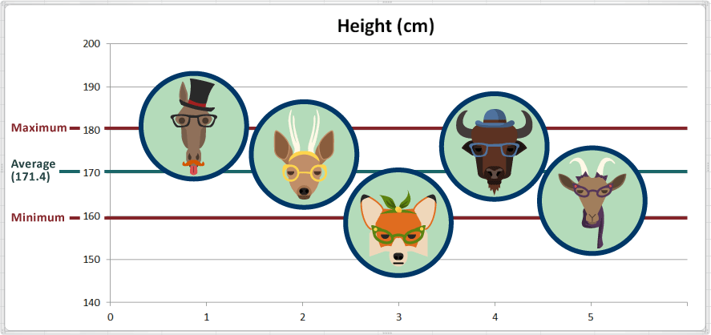
REVIEW
What are the measure of dispersion?
Measures of dispersion are used to measure how far the spread of the data
is from the mean
Examples:
Range
Mean Absolute Deviation
Variance
Standard Deviation

Slide 3
REVIEW
Why do we need to study the measure of dispersion?
The marks of two students in eight subjects are shown in the table below
Subject | Math | Physics | Chemistry | Biology | English | Social | Art | Physical Education
Mary | 57 | 55 | 62 | 52 | 54 | 45 | 57 | 66
Tom | 85 | 32 | 55 | 87 | 24 | 77 | 49 | 39
Mean=56
Mean=56
Conclusion
Mary’s marks are 5 points away from the mean.
Tom’s marks are about 8 points away from the mean.
Marks of Tom are much more spread out than those of Mary
This information can be used by the teachers to determine the best method of responding to individual needs of each student.
It will help teachers know the area of weaknesses and strengths of their learners in particular subject.
Measures of Dispersion are very important during decision making

Slide 4
Standard Deviation
What is standard deviation?
This is a statistical measure that shows the spread of values in a particular data.
It is calculated by taking the square root of Variance.
$$Standard deviation= \sqrt{Variance}$$
What is variance?
Variance is the mean of the square of deviations from the mean.
Find the mean, variance & standard deviation of the following scores 10, 8, 10, 8, 8 & 4.
Mean = (10+8+10+8+8+4) = 48 ÷ 6 = 8
Variance = ($2^{2}$ + $0^{2}$ + $2^{2}$+$0^{2}$+$0^{2}$+${(−4)}^{2}$) over 8 = 24 ÷ 6 = 4
Standard deviation = $\sqrt{Variance}$ = $\sqrt{4}$ = 2
Standard Deviation, entirely depends on variance

Slide 5
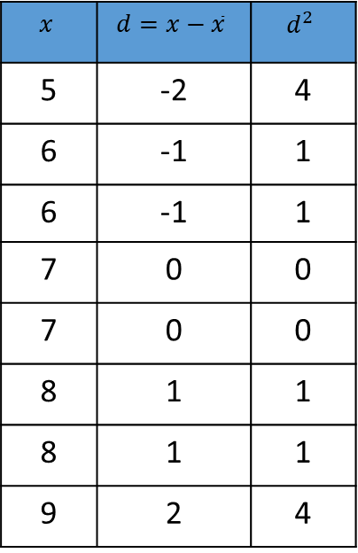
Standard Deviation (Simple List of Numbers)
Example 1: The age of some grade 1 pupils were recorded by their teacher as follows : 5,6,6,7,7,8,8,9
a-Calculate their mean age :
$$\frac{5+6+6+7+7+8+8+9}{8}=7$$
b-Calculate the variance:
$$x$$ | $$d=x−\overline{x}$$ | $$d^{2}$$
5 | -2 | 4
6 | -1 | 1
6 | -1 | 1
7 | 0 | 0
7 | 0 | 0
8 | 1 | 1
8 | 1 | 1
9 | 2 | 4
$$variance= \sum{\frac{d^{2}}{N}}$$
c- Calculate the standard deviation:
$$Standard deviation= \sqrt{variance}$$
$$variance=\frac{4+1+1+0+0+1+1+4}{8}$$
$$Standard deviation= \sqrt{1.5}$$
$$variance=1.5$$
$$Standard deviation=1.225$$

Slide 6
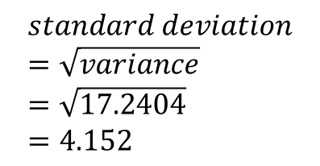
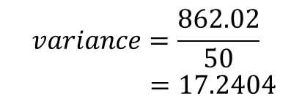
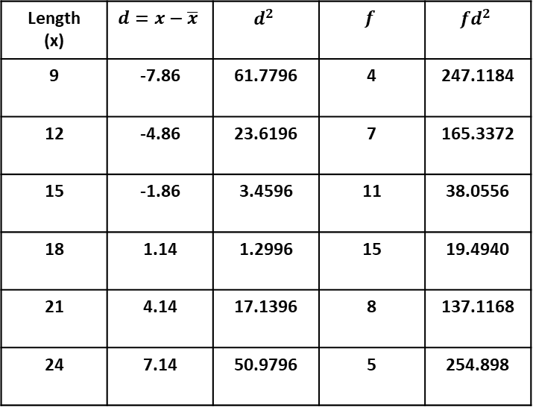
Standard Deviation ( Frequency Distribution Table)
Example 2: In an agricultural research center, the length of a sample of 50 maize cobs were measured and recorded as shown in the frequency distribution table below.
Length in cm | 9 | 12 | 15 | 18 | 21 | 24
Number of Cobs | 4 | 7 | 11 | 15 | 8 | 5
a-Calculate the mean :
b-Calculate the variance & standard deviation:
Length (x) | Number of Cobs (f) | fx
9 | 4 | 36
12 | 7 | 84
15 | 11 | 165
18 | 15 | 270
21 | 8 | 168
24 | 5 | 120
Length (x) | $$d=x−\overline{x}$$ | $$d^{2}$$ | $$f$$ | $$fd^{2}$$
9 | -7.86 | 61.7796 | 4 | 247.1184
12 | -4.86 | 23.6196 | 7 | 165.3372
15 | -1.86 | 3.4596 | 11 | 38.0556
18 | 1.14 | 1.2996 | 15 | 19.4940
21 | 4.14 | 17.1396 | 8 | 137.1168
24 | 7.14 | 50.9796 | 5 | 254.898
$$variance=\frac{\sum{fd^{2}}}{\sum{f}}$$
$$Mean=\frac{\sum{fx}}{\sum{f}}$$
$$variance=\frac{862.02}{50}$$
$=17.2404$
$$Mean=\frac{843}{50}=16.86$$
$$standard deviation=\sqrt{variance} \\ =\sqrt{17.2404} \\ =4.152$$

Slide 7
Application using CASIO fx-82EX
Example 2: In an agricultural research center, the length of a sample of 50 maize cobs were measured and recorded as shown in the frequency distribution table below.
Length in cm | 9 | 12 | 15 | 18 | 21 | 24
Number of Cobs | 4 | 7 | 11 | 15 | 8 | 5
Complete the table below
Length (x) | Number of Cobs (f)
9 | 4
12 | 7
15 | 11
18 | 15
21 | 8
24 | 5
We will use CASIO fx-82EX
( Reduce time while calculating)
CT2

Slide 8
Assignment
1- Explain how measures of dispersion (standard of deviation) can be applied in the real life examples/situation.
2- The marks obtained by 10 pupils in an English test were 15,14,12,13,p,16,11,13,12,and 17.
The sum of the squares of the marks $\sum{x^{2}}$ is 1794.
Calculate (i) Value of p.
(ii) Standard deviation.

Slide 9
Thank You Very Much!

