Slide 1
Mathematics Tutorial Session
Area Approximation Using
Trapezium Rule

Slide 2
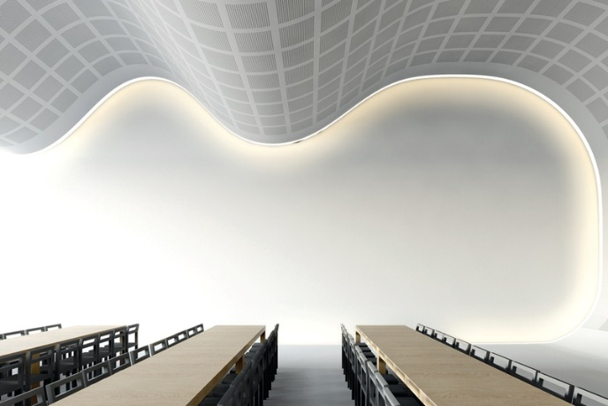
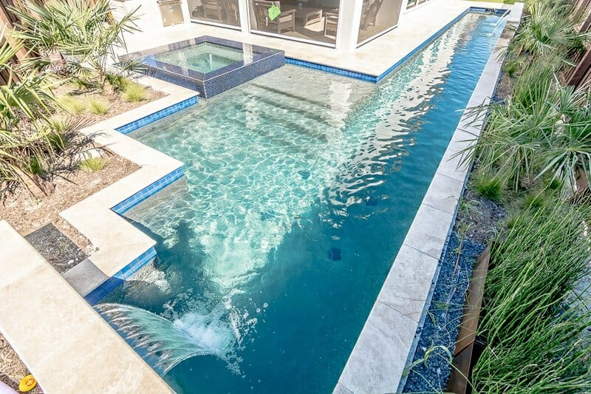
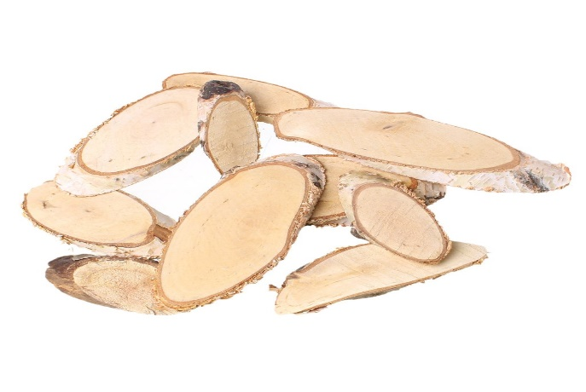
Irregular Natural Shapes
Most of shapes in real the real life situation are mainly irregular.
What are some of these natural shapes?
How to approximate the area of such
irregular shapes?

Slide 3
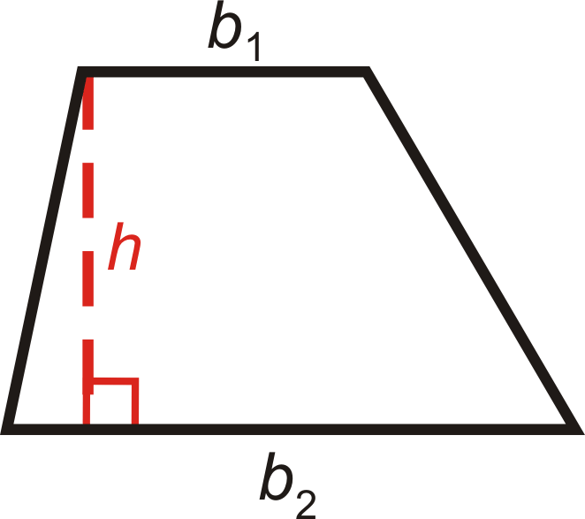
Trapezium
1-What is a trapezium ?
Recall :
A trapezium is a quadrilateral with one pair of parallel sides
2- What is the area of a trapezium?
Recall:
Area of Trapezium = $\frac{1}{2}h(b_{1}+b_{2})$ where “h” is the perpendicular distance between the two bases.

Slide 4
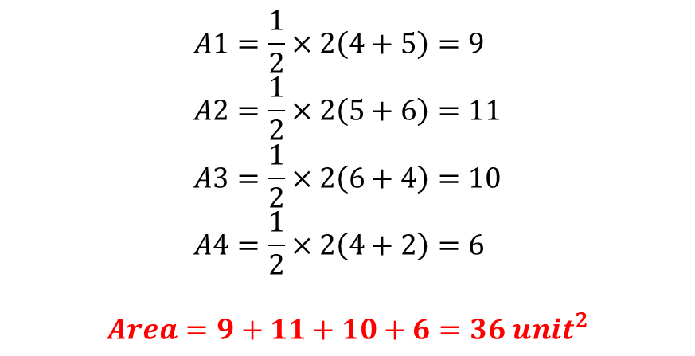
Estimate Area under the curve
Estimate the area under the curve as shown on the diagram below
Steps to estimate area under curve using Trapezium rule
What is the area under the curve?
1- Divide the region into several trapezia of uniform height.
2- Calculate the area of each trapezium
3- Area under curve = A1+A2+A3+A4
y-axis
Solution
$$A1=\frac{1}{2}×2\left(4+5\right)=9 \\ A2=\frac{1}{2}×2\left(5+6\right)=11 \\ A3=\frac{1}{2}×2\left(6+4\right)=10 \\ A4=\frac{1}{2}×2\left(4+2\right)=6$$
$$Area=9+11+10+6=36 unit^{2}$$
4
5
6
4
2
A1
A2
A3
A4
h=2
h=2
h=2
h=2
x-axis
Area under the curve is defined by the curve , x-axis and two vertical lines

Slide 5
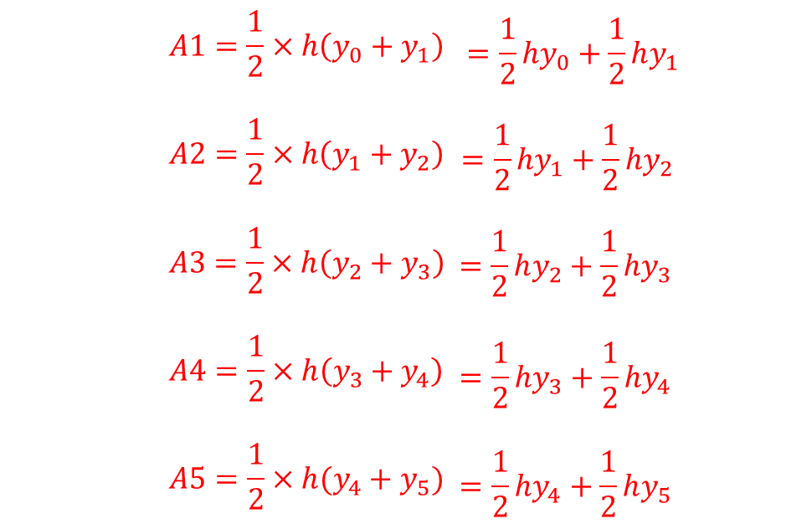
Deriving Trapezium Rule
Estimate area under the curve
y-axis
a) How many strips are formed under the curve?
5 strips
b)What are the ordinates of b1 and b2 of 1st strip and that of the 2nd strip?
For 1st Strip : $b1=y_{0} and b2=y_{1}$
For 2nd Strip: $b1=y_{1}and b2=y_{2}$
$$y_{0}$$
$$y_{1}$$
$$y_{2}$$
$$y_{3}$$
$$y_{4}$$
$$y_{5}$$
A1
A2
A3
A4
A5
c) Calculate the area of each strip
h
h
h
h
h
x-axis

Slide 6

Deriving Trapezium Rule
Estimate area under the curve and simplify your answer
y-axis
$$A1=\frac{1}{2}×h\left(y_{0}+y_{1}\right)$$
$$A2=\frac{1}{2}×h\left(y_{1}+y_{2}\right)$$
$$A3=\frac{1}{2}×h\left(y_{2}+y_{3}\right)$$
$$A4=\frac{1}{2}×h\left(y_{3}+y_{4}\right)$$
$$A5=\frac{1}{2}×h(y_{4}+y_{5})$$
$$=\frac{1}{2}hy_{0}+\frac{1}{2}hy_{1}$$
$$=\frac{1}{2}hy_{1}+\frac{1}{2}hy_{2}$$
$$=\frac{1}{2}hy_{2}+\frac{1}{2}hy_{3}$$
$$y_{0}$$
$$y_{1}$$
$$y_{2}$$
$$y_{3}$$
$$y_{4}$$
$$y_{5}$$
$$=\frac{1}{2}hy_{3}+\frac{1}{2}hy_{4}$$
A1
A2
A3
A4
A5
h
h
h
h
h
x-axis
$$=\frac{1}{2}hy_{4}+\frac{1}{2}hy_{5}$$
Area under curve = A1+A2+A3+A4+A5
$Area=\frac{1}{2}hy_{0}+\frac{1}{2}hy_{1}$+$\frac{1}{2}hy_{1}+\frac{1}{2}hy_{2}$+$\frac{1}{2}hy_{2}+\frac{1}{2}hy_{3}$+$\frac{1}{2}hy_{3}+\frac{1}{2}hy_{4}$+$\frac{1}{2}hy_{4}+\frac{1}{2}hy_{5}$
$Area=\frac{1}{2}h(y_{0}+y_{1}+y_{1}+y_{2}+y_{2}+y_{3}+y_{3}+y_{4}+y_{4}+y_{5}$)
$$Area=\frac{1}{2}h[y_{0}+y_{5}+{2(y}_{1}+y_{2}+y_{3}+y_{4})]$$

Slide 7
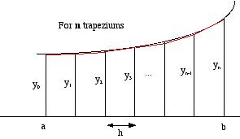

Deriving Trapezium Rule
In General :
$$Estimated Area "A"=Sum of trapezia area formed under the curve$$
$$A=A1+A2+A3+A4+…+An$$
$$A=\frac{{h(y}_{0}+y_{1})}{2}+\frac{{h(y}_{1}+y_{2})}{2}+…+\frac{h(y_{n−1}+y_{n})}{2}$$
$$A= \frac{1}{2}×h[y_{0}+y_{n}+2\left(y_{1}+y_{2}+…+y_{n−1}\right)]$$
For n Trapezia
A1
A2
A3
An
n= number if strips

Slide 8
Trapezium Rule
Example 1
Estimate the area bounded by the curve $y=\frac{1}{2}x^{2}+5$, the x-axis , the two lines x=0 and x=5 using trapezium rule, with h=1
X | 0 | 1 | 2 | 3 | 4 | 5
y | 5 | 5.5 | 7 | 9.5 | 13 | 17.5
$$A=\frac{1}{2}×h[y_{0}+y_{5}+2\left(y_{1}+y_{2}+y_{3}+y_{4}\right)]$$
$$A=\frac{1}{2}×1[5+17.5+2\left(5.5+7+9.5+13\right)]$$
$$=46.25 square units$$

Slide 9
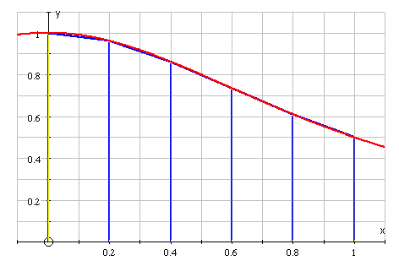
Trapezium Rule
Example 2
Estimate the area under the curve $y=\frac{1}{1+x^{2}} bounded$
By x-axis, y-axis and the lines x=0 and x=1 with h=0.2
For each value of x, we calculate the y-values, using the function, and writing the values in a table.
1st : Construct a table of values with domain $x∈\left[0,1\right]$ with interval width h=0.2
x | 0 | 0.2 | 0.4 | 0.6 | 0.8 | 1
y | 1 | 0.9615 | 0.8621 | 0.7353 | 0.6098 | 0.5
y
We will use CASIO fx-82EX
To construct the table of values
( Reduce time while evaluating)
$$Area=\frac{1}{2}×0.2×\left(1+0.5+2\left(0.9615+0.8621+0.7353+0.6098\right)\right) \\ Area=0.78374 unit^{2}$$

Slide 10
Trapezium Rule ( Assignment )
Question 1
Identify real life examples where trapezium rule is applicable.
Question 2
A) Complete the table below for the function $y=x^{2}−3x−4$
x | -4 | -3.5 | -3 | -2.5 | -2 | -1.5 | -1 | -0.5 | 0 | 0.5 | 1
y
B) Use the table and the trapezium rule with 11 strips to estimate the area bounded by the curve $y=x^{2}−3x−4$, x= - 4, x = 1 and the x-axis

Slide 11
Thank You Very Much!

